Slide 1

Job Analyst
Submitted by : Amit Porwal , Madhu Gupta & shubhum Pathak
Mentored by : Manish Hemnani
Project start Date : 30 / 08 / 2023
Project end Date : 03 / 09 / 2023

Slide 2
Project Overview
The "Job Analyst" project is a data analysis endeavor that centers around job vacancy data sourced from the Instahyre website. The project's primary objective is to extract valuable insights from this data to gain a better understanding of the job market.
The project is a collaborative effort involving three team members—Amit Porwal, Madhu Gupta, and Shubhum—under the guidance and mentorship of Manish Hemnani. Each member plays a crucial role in different project phases, such as data scraping, cleaning, preprocessing, and analysis.
The project can be divided into distinct phases, including data scraping, data cleaning, data preprocessing, data modeling (structuring data into tables), SQL query execution for analysis, and the creation of an Excel dashboard. These milestones collectively contribute to the project's success in delivering meaningful insights about job vacancies.

Slide 3
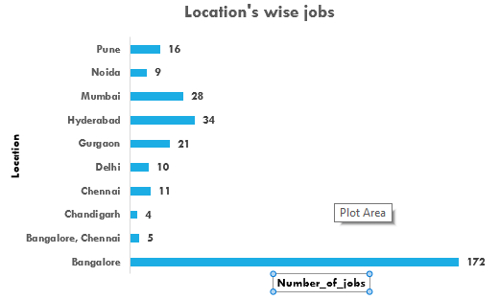
Bangalore has the highest job openings while Chandigarh has the least job openings in top 10.

Slide 4
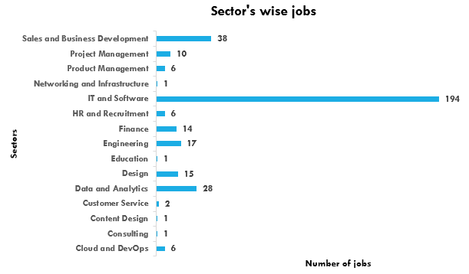
IT and Software sector has the highest job openings industry in IT sector.
While Education , Content Design , consulting and Networking and Infrastructure sectors has lowest job openings.

Slide 5
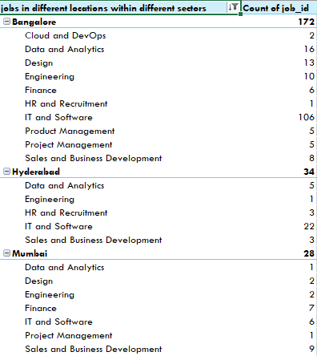
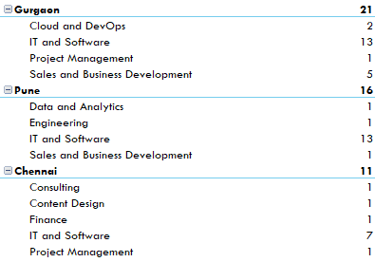
Top 6 records with number of job in different locations within different sectors.
In all top 6 cities , IT and Software has the highest job producing sector.

Slide 6
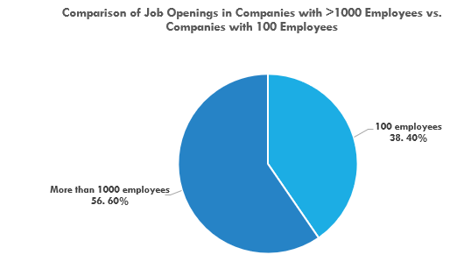
In comparison of company size with more than 1000 employees vs companies with 100 employees.
56.60% companies that have more than 1000 employees while 38.40% companies that have 100 employees.

Slide 7
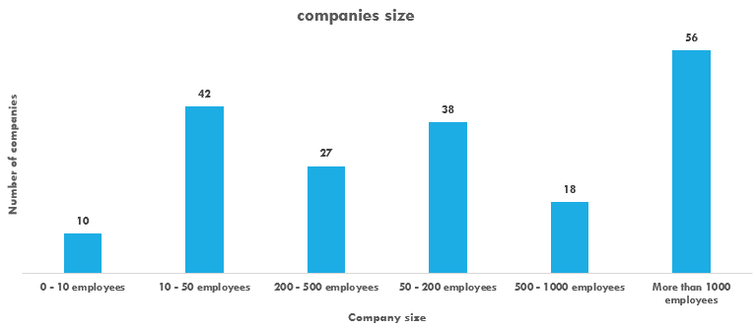
56 companies has more than 1000 employees out of 340 records.
42 companies has 10-50 employees in company.
While 0-10 employees size companies is very less.

Slide 8
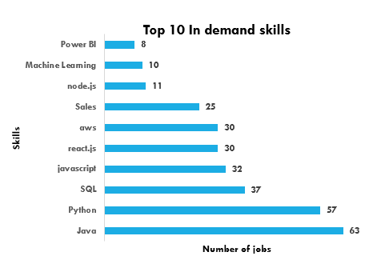
Java and Python have highest in demand skills in IT industry.
SQL has third most in demand skill.

Slide 9
Conclusion
Regional Disparities: Bangalore emerges as the top city with the highest job openings, while Chandigarh lags behind in the top 10 cities. This regional disparity in job opportunities highlights the importance of location in the job market.
IT Dominance: The IT and Software sector leads the pack with the highest job openings in the IT industry. Conversely, sectors like Education, Content Design, Consulting, and Networking and Infrastructure exhibit comparatively lower job openings. This emphasizes the demand for tech-related skills in today's job market.
City-Sector Dynamics: Across the top six cities, IT and Software consistently stands out as the leading sector in terms of job openings.
Company Size Impact: Larger companies with more than 1000 employees account for 56.60% of the dataset, showcasing their dominance in the job market. In contrast, smaller companies with 100 employees make up 38.40% of the dataset, reflecting the diversity of company sizes in the job landscape.

Slide 10
Conclusion
Company Size Breakdown: Among the dataset, 56 companies are large-scale organizations with more than 1000 employees, while 42 companies fall within the 10-50 employee range. However, companies with fewer than 10 employees are relatively scarce, suggesting that mid-sized companies play a significant role in job creation.
In-Demand Skills: Java and Python emerge as the most sought-after skills in the IT industry, with SQL closely following. This underscores the importance of programming and database management skills for job seekers in the tech sector.
In conclusion, these insights provide a comprehensive overview of the job market's dynamics, emphasizing the regional variations, sector-specific trends, company size impacts, and the significance of specific skills in the IT industry.

